Slide 1
Ethernet Protocol
TCP/IP accepts any protocol at these two layers that can provide services to the network layer
data-link layer and the physical layer are actually the territory of the local and wide area networks
Local area network (LAN) is a computer network that is designed for a limited geographic area such as a building or a campus
In the 1980s and 1990s several different types of LANs were used
problem of sharing the media
Solution media-access method
Notes:
Ethernet used the CSMA/CD approach

Slide 2
Type of LAN
Type of LAN | media-access method
Ethernet | CSMA/CD approach
Token Ring/Bus, and FDDI (Fiber Distribution Data Interface) | token-passing approach
disappeared from the marketplace because Ethernet was able to update itself to meet the needs of the time
ATM LAN deployed the high speed WAN technology
An organization that has used an Ethernet LAN in the past and now needs a higher data rate would update to the new generation Ethernet instead of switching to another technology, which might cost more

Slide 3
IEEE standard
In 1985, the Computer Society of the IEEE started a project, called Project 802
Set standards to enable intercommunication among equipment from a variety of manufacturers
does not seek to replace any part of the OSI model or TCP/IP protocol suite
a way of specifying functions of the physical layer and the data-link layer of major LAN protocols
The IEEE has subdivided the data-link layer into two sublayers:
logical link control (LLC)
Media access control (MAC)
IEEE has also created several physical-layer standards for different LAN protocols.

Slide 4
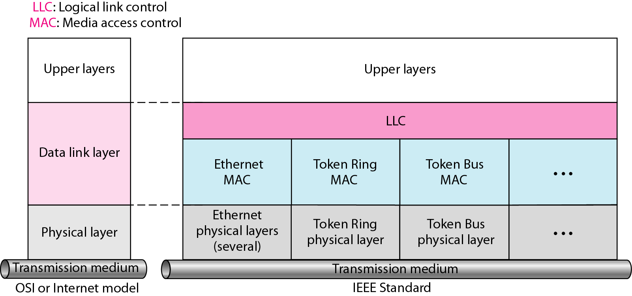
IEEE standard for LANs

Slide 5
Logical Link Control (LLC)
OSI or TCP/IP Data link control handles framing, flow control, and error control
In IEEE Project 802, flow control, error control, and part of the framing duties are collected into one sublayer called the logical link control (LLC)
Framing is handled in both the LLC sublayer and the MAC sublayer
The LLC provides a single link-layer control protocol for all IEEE LANs
LLC protocol can provide interconnectivity between different LANs because it makes the MAC sublayer transparent.

Slide 6
Media Access Control (MAC)
OSI or TCP/IP multiple access methods including random access, controlled access, and channelization
IEEE Project 802 has created a sublayer called media access control that defines the specific access method for each LAN
CSMA/CD as the media access method for Ethernet LANs
Token-passing method for Token Ring and Token Bus LANs
Part of the framing function is also handled by the MAC layer in IEEE 802

Slide 7
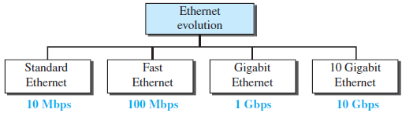
Ethernet Evolution
The Ethernet LAN was developed in the 1970s by Robert Metcalfe and David Boggs.
Since then, it has gone through four generations
Standard Ethernet (10 Mbps)
Fast Ethernet (100 Mbps)
Gigabit Ethernet (1 Gbps)
10 Gigabit Ethernet (10 Gbps)

Slide 8
Standard Ethernet
Original Ethernet technology with the data rate of 10 Mbps
Although most implementations have moved to other technologies in the Ethernet evolution, there are some features of the Standard Ethernet that have not changed during the evolution
Characteristics of the Standard Ethernet
Connectionless and Unreliable Service
Frame Format
Frame Length
Notes:
IEEE standard 802.3

Slide 9
Connectionless and Unreliable Service
A connectionless service means each frame sent is independent of the previous or next frame
Ethernet has no connection establishment or connection termination phases
The sender sends a frame whenever it has it; the receiver may or may not be ready for it.
The sender may overwhelm the receiver with frames, which may result in dropping frames
If a frame drops, the sender will not know about it
Since IP, which is using the service of Ethernet, is also connectionless
If the transport layer is also a connectionless protocol, such as UDP, the frame is lost and salvation may only come from the application layer
If the transport layer is TCP, the sender TCP does not receive acknowledgment for its segment and sends it again

Slide 10
Connectionless and Unreliable Service
Ethernet is also unreliable like IP and UDP
If a frame is corrupted during transmission and the receiver finds out about the corruption, which has a high level of probability of happening because of the CRC-32, the receiver drops the frame silently
It is the duty of high-level protocols to find out about it

Slide 11
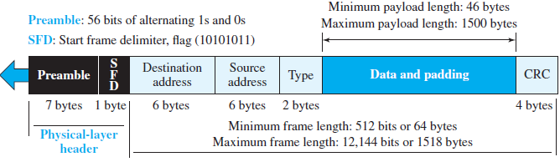
Ethernet frame
Remember that an Ethernet frame is a variable-length frame
Contains seven fields

Slide 12
Ethernet frame
Preamble. This field contains 7 bytes (56 bits) of alternating 0s and 1s
alert the receiving system to the coming frame
enable it to synchronize its clock if it’s out of synchronization
The pattern provides only an alert and a timing pulse
The 56-bit pattern allows the stations to miss some bits at the beginning of the frame
actually added at the physical layer and is not (formally) part of the frame

Slide 13
Ethernet frame
Start frame delimiter (SFD)
1 byte: 10101011) signals the beginning of the frame as the size of Ethernet frame is variable size
The SFD warns the station or stations that this is the last chance for synchronization
The last 2 bits are (11)₂ and alert the receiver that the next field is the destination address
The SFD field is also added at the physical layer

Slide 14
Ethernet frame
Destination address (DA)
Six bytes (48 bits)
contains the linklayer address of the destination station or stations to receive the packet
When the receiver sees its own link-layer address, or a multicast address for a group that the receiver is a member of, or a broadcast address, it decapsulates the data from the frame and passes the data to the upperlayer protocol defined by the value of the type field
Source address (SA)
Six bytes and contains the link-layer address of the sender of the packet

Slide 15
Ethernet frame
Type
Defines the upper-layer protocol whose packet is encapsulated in the frame
This protocol can be IP, ARP, OSPF, and so on
It is used for multiplexing and demultiplexing.

Slide 16
Ethernet frame
Data
encapsulated from the upper-layer protocols
minimum of 46 and a maximum of 1500 bytes
If the data coming from the upper layer is more than 1500 bytes, it should be fragmented and encapsulated in more than one frame
If it is less than 46 bytes, it needs to be padded with extra 0s
A padded data frame is delivered to the upper-layer protocol as it is (without removing the padding)
means that it is the responsibility of the upper layer to remove or, in the case of the sender, to add the padding
The upper-layer protocol needs to know the length of its data. For example, a datagram has a field that defines the length of the data

Slide 17
Ethernet frame
CRC
contains error detection information, in this case a CRC-32
The CRC is calculated over the addresses, types, and data field
If the receiver calculates the CRC and finds that it is not zero (corruption in transmission), it discards the frame.

Slide 18
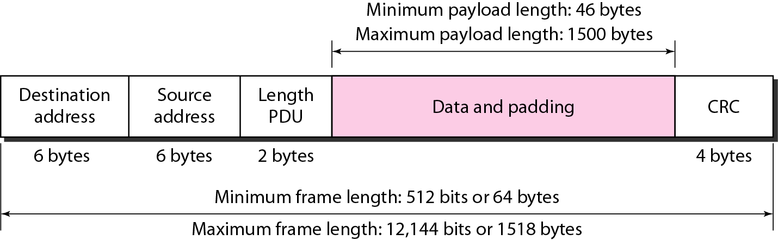
Frame Length
Ethernet has imposed restrictions on both the minimum and maximum lengths of a frame
The minimum length restriction is required for the correct operation of CSMA/CD
An Ethernet frame - a minimum length of 512 bits or 64 bytes
Part of the length is the header and the trailer
If 18 bytes of header and trailer (6 bytes of source address, 6 bytes of destination address, 2 bytes of length or type, and 4 bytes of CRC), then the minimum length of data from the upper layer is 64 − 18 = 46 bytes
If the upper-layer packet is less than 46 bytes, padding is added to make up the difference

Slide 19
Frame Length
The standard defines the maximum length of a frame (without preamble and SFD field) as 1518 bytes
If we subtract the 18 bytes of header and trailer, the maximum length of the payload is 1500 bytes
The maximum length restriction has two historical reasons
First, memory was very expensive when Ethernet was designed; a maximum length restriction helped to reduce the size of the buffer
Second, the maximum length restriction prevents one station from monopolizing the shared medium, blocking other stations that have data to send
frame length in bytes |  | data length in bytes
Minimum | Maximum | Minimum | Maximum
64 | 1518 | 46 | 1500

Slide 20
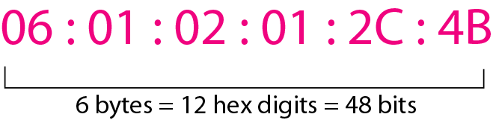
Standard Ethernet - Addressing
Each station on an Ethernet network (such as a PC, workstation, or printer) has its own network interface card (NIC)
The NIC fits inside the station and provides the station with a link-layer address
The Ethernet address is 6 bytes (48 bits), normally written in hexadecimal notation, with a colon between the bytes

Slide 21

Standard Ethernet - Addressing
A source address is always a unicast address—the frame comes from only one station
The destination address can be unicast, multicast, or broadcast
If the least significant bit of the first byte in a destination address is 0, the address is unicast; otherwise, it is multicast.
The broadcast address is a special case of the multicast address: the recipients are all the stations on the LAN
A broadcast destination address is forty-eight 1s

Slide 22
Standard Ethernet - Addressing
Define the type of the following destination addresses:
a. 4A:30:10:21:10:1A
b. 47:20:1B:2E:08:EE
c. FF:FF:FF:FF:FF:FF
Look at the second hexadecimal digit from the left to find the type of the address
If it is even, the address is unicast
If it is odd, the address is multicast
If all digits are Fs, the address is broadcast
a. This is a unicast address because A in binary is 1010 (even)
b. This is a multicast address because 7 in binary is 0111 (odd)
c. This is a broadcast address because all digits are Fs in hexadecimal

Slide 23

Transmission of Address Bits
Addresses are sent out online using different way they are written in hexadecimal notation
The transmission is left to right, byte by byte
Each byte, the least significant bit is sent first and the most significant bit is sent last
bit that defines an address as unicast or multicast arrives first at the receiver
Receiver to immediately know if the packet is unicast or multicast
How the address 47:20:1B:2E:08:EE is sent out online?

Slide 24
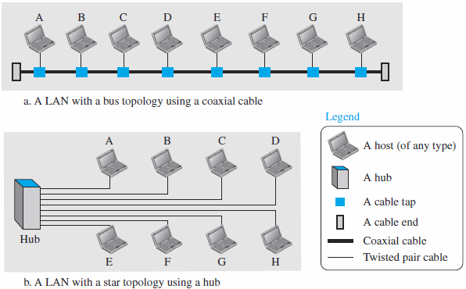
Medium in standard Ethernet
Standard Ethernet uses a coaxial cable (bus topology) or a set of twisted-pair cables with a hub (star topology)

Slide 25
Unicast, Multicast, and Broadcast Transmission
Transmission in the standard Ethernet is always broadcast, no matter if the intention is unicast, multicast, or broadcast
In the bus topology, when station A sends a frame to station B, all stations will receive it
In the star topology, when station A sends a frame to station B, the hub will receive it
Since the hub is a passive element, it does not check the destination address of the frame; it regenerates the bits (if they have been weakened) and sends them to all stations except station A
In fact, it floods the network with the frame
How the actual unicast, multicast, and broadcast transmissions are distinguished from each other?
It is based on the way the frames are kept or dropped

Slide 26
Unicast, Multicast, and Broadcast Transmission
transmission | all stations (except the sender) | intended recipient keeps and handles the frame | Non- intended recipient
unicast | receive the frame | destination | discard it
multicast | receive the frame | members of the group | discard it
broadcast | receive the frame | all stations (except the sender) | -
Notes:
In a unicast transmission, all stations will receive the frame, the intended recipient keeps and handles the frame; the rest discard it
In a multicast transmission, all stations will receive the frame, the stations that are members of the group keep and handle it; the rest discard it
In a broadcast transmission, all stations (except the sender) will receive the frame and all stations (except the sender) keep and handle it.

Slide 27
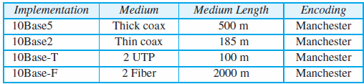
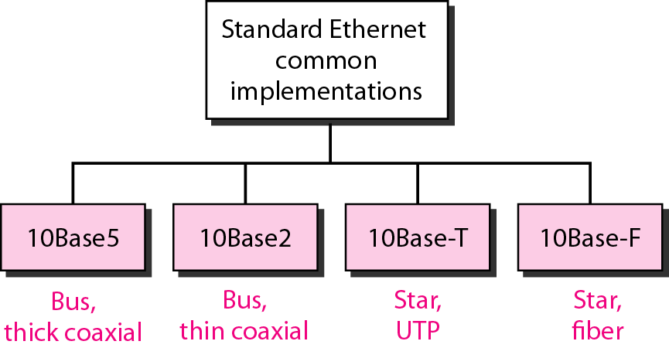
Standard Ethernet Implementations
Four popular standard Ethernet implementations during the 1980s

Slide 28
IEEE 802.11 Wireless LAN Standard
In response to lacking standards, IEEE developed the first internationally recognized wireless LAN standard – IEEE 802.11
IEEE published 802.11 in 1997, after seven years of work
Scope of IEEE 802.11 is limited to Physical and Data Link Layers.
wireless Ethernet or WiFi (short for wireless fidelity) or wireless LAN
WiFi Alliance is a global, nonprofit industry association of more than 300 member companies devoted to promoting the growth of wireless LANs

Slide 29
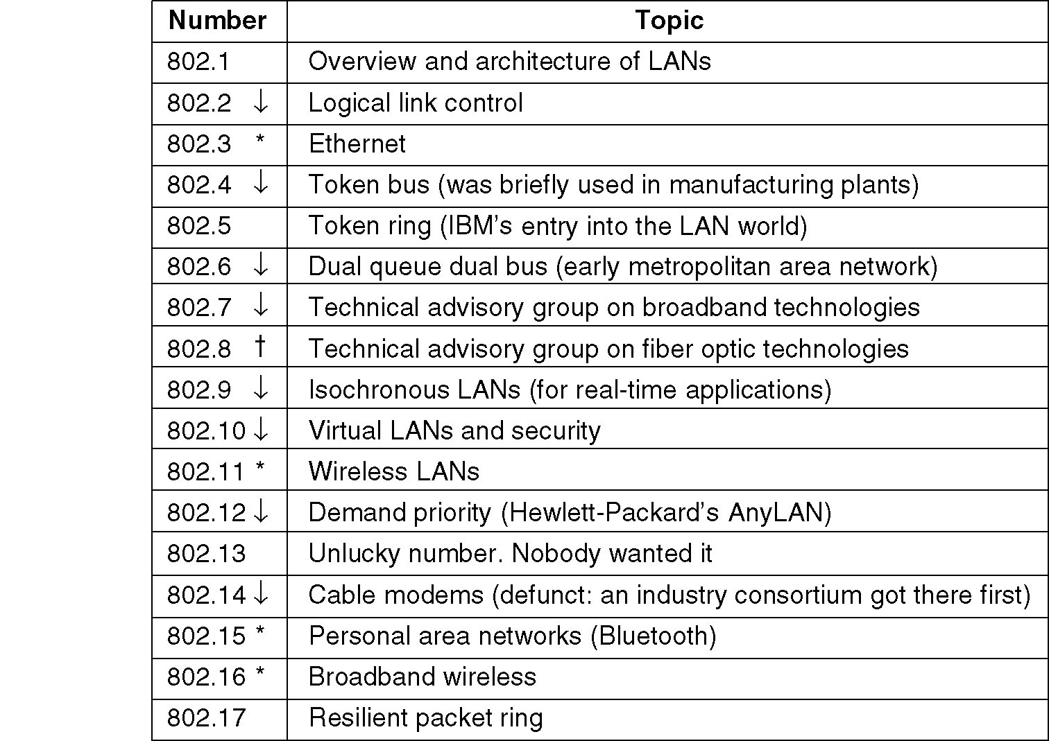
IEEE 802 Standards Working Groups
The important ones are marked with *. The ones marked with ↓ are hibernating. The one marked with † gave up.

Slide 30
Benefits of 802.11 Standard
Appliance Interoperability
Fast Product Development
Stable Future Migration
Price Reductions
The 802.11 standard takes into account the following significant differences between wireless and wired LANs:
Power Management
Security
Bandwidth

Slide 31
IEEE 802.11 Terminology
Access point (AP): A station that provides access to the DS.
Basic service set :
a set is of stationary or mobile wireless stations and an optional central base station, known as the access point (AP).
Distribution system (DS): A system used to interconnect a set of BSSs to create an ESS.
DS is implementation-independent. It can be a wired 802.3 Ethernet LAN, 802.4 token bus, 802.5 token ring or another 802.11 medium.
Extended service set (ESS):Two or more BSS interconnected by DS
extended service set uses two types of stations: mobile and stationary
The mobile stations are normal stations inside a BSS. The stationary stations are AP stations that are part of a wired LAN.

Slide 32
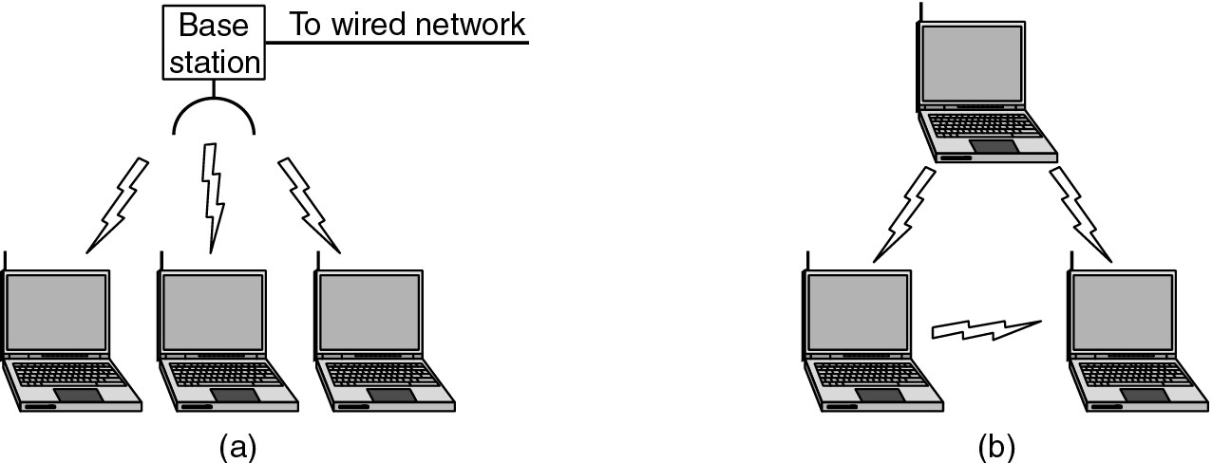
Categories of Wireless Networks
Base Station :: all communication through an access point {note hub topology}. Other nodes can be fixed or mobile.
Infrastructure Wireless :: base station network is connected to the wired Internet.
Ad hoc Wireless :: wireless nodes communicate directly with one another.
MANETs (Mobile Ad Hoc Networks) :: ad hoc nodes are mobile.
(a) Wireless networking with a base station. (b) Ad hoc networking.

Slide 33
Architecture
The standard defines two kinds of services:
the basic service set (BSS)
building blocks of a wireless LAN
made of stationary or mobile wireless stations and an optional central base station, known as the access point (AP)
the extended service set (ESS)
made up of two or more BSSs with Aps
Three types of stations based on their mobility in a wireless LAN:
no-transition - either stationary (not moving) or moving only inside a BSS
BSS-transition mobility - move from one BSS to another, but the movement is confined inside one ESS
ESS-transition mobility - move from one ESS to another
IEEE 802.11 does not guarantee that communication is continuous during the move
Notes:
IEEE 802.11 defines three types of stations based on their mobility in a wireless LAN:
no-transition
A station is either stationary (not moving) or moving only inside a BSS
BSS-transition
station can move from one BSS to another, but the movement is confined inside one ESS.
ESS-transition mobility
A station can move from one ESS to another

Slide 34
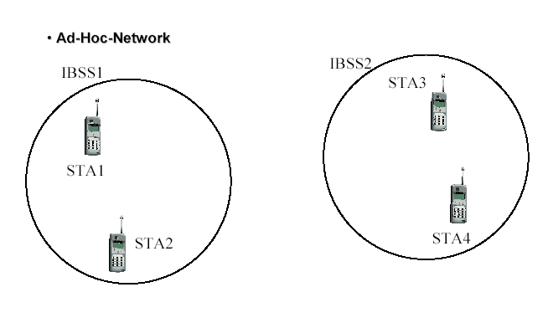
WLAN Topology - Ad-Hoc Network
The BSS without an AP is a stand-alone network and cannot send data to other BSSs
They can locate one another and agree to be part of a BSS

Slide 35
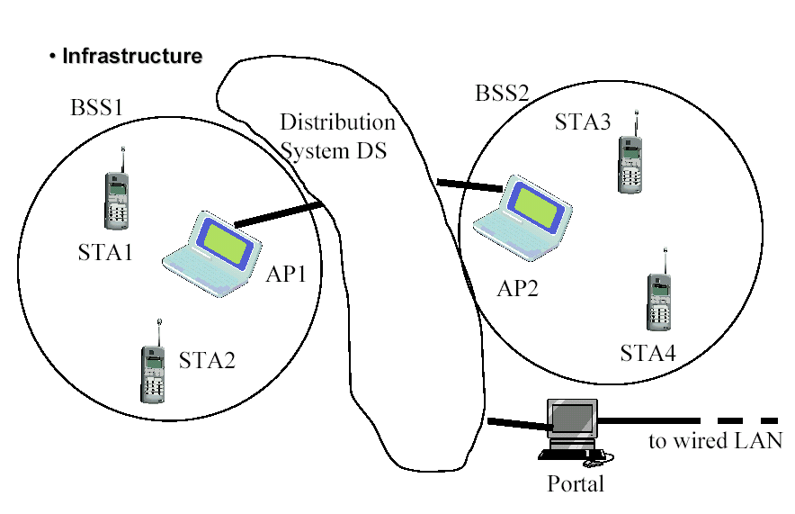
WLAN Topology Infrastructure
EX: cellular network if we consider each BSS to be a cell and each AP to be a base station.

Slide 36
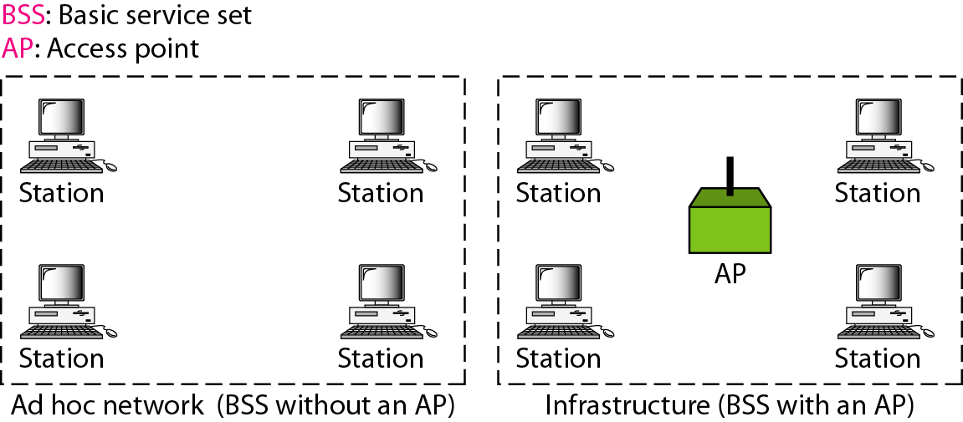
Basic service sets (BSSs)
Building blocks of a wireless LAN
Made of stationary or mobile wireless stations and an optional central base station, known as the access point (AP)
The BSS without an AP is a stand-alone network and cannot send data to other BSSs - an ad hoc architecture
stations can locate one another and agree to be part of a BSS
A BSS with an AP is sometimes referred to as an infrastructure BSS.

Slide 37
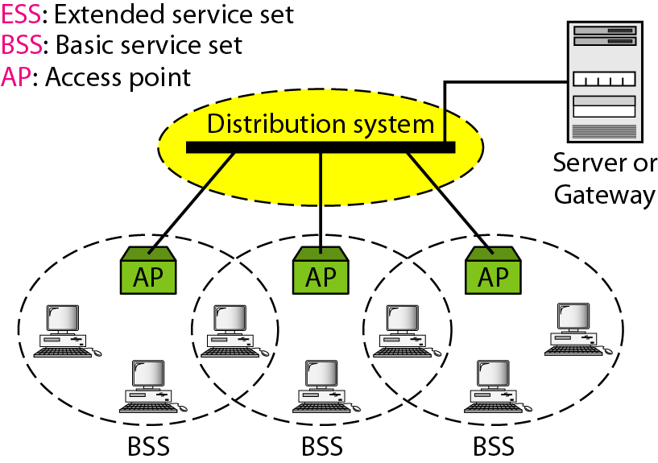
Distribution of Messages
Distribution service (DS) - connects the APs in the BSSs
Used to exchange MAC frames from station in one BSS to station in another BSS
When BSSs are connected, the stations within reach of one another can communicate without the use of an AP
uses two types of stations:
mobile - normal stations inside a BSS
Stationary - AP stations that are part of a wired LAN
A mobile station can belong to more than one BSS at the same time
Notes:
made up of two or more BSSs with Aps
APs in BSSs are connected through a distribution system, which is a wired or a wireless network
IEEE 802.11 does not restrict the distribution system; it can be any IEEE LAN such as an Ethernet
uses two types of stations:
mobile - normal stations inside a BSS
Stationary - AP stations that are part of a wired LAN

Slide 38
Fragmentation
The wireless environment is very noisy.
corrupt frame has to be retransmitted.
Fragmentation is recommended.
the division of a large frame into smaller ones.
It is more efficient to resend a small frame than a large one.

Slide 39
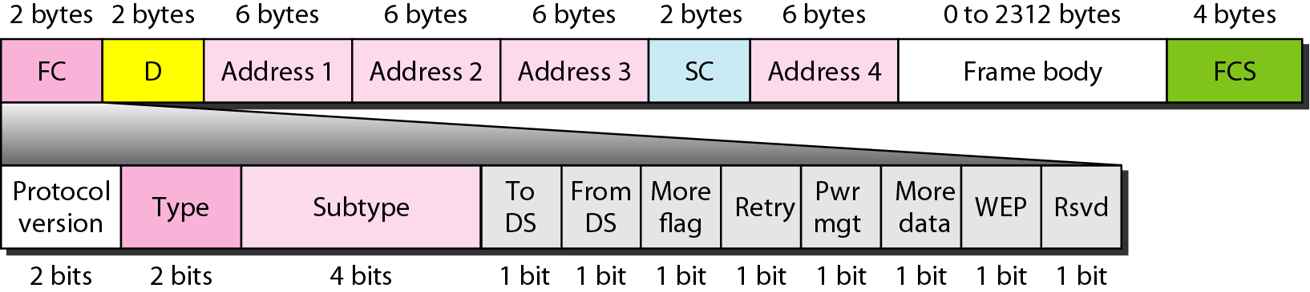
MAC Frame Format
The MAC layer frame consists of nine fields
duration of the transmission that is used to set the value of NAV. In one control frame, it defines the ID of the frame.
Sequence control (SC) - first four bits define the fragment number; the last 12 bits define the sequence number, which is the same in all fragments.
Frame body - information based on the type and the subtype defined in the FC field
four address fields - meaning of each address field depends on the value of the To DS and From DS subfields
FCS - CRC-32 error-detection sequence
Frame control (FC)- type of frame and some control information

Slide 40
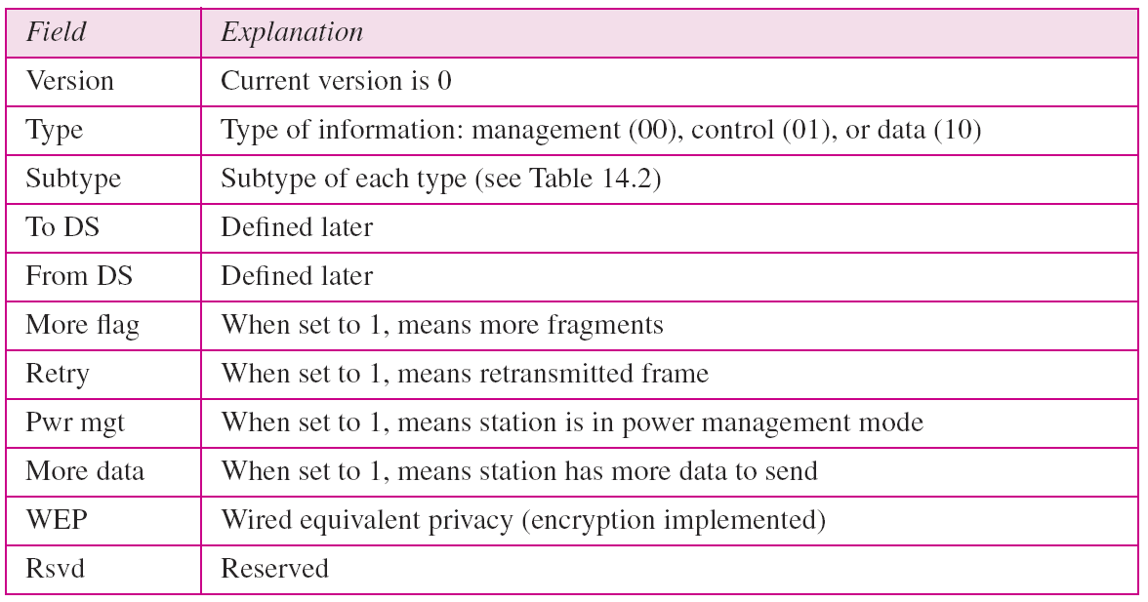
MAC Sublayer - Frame Format
Subfields in FC field

Slide 41
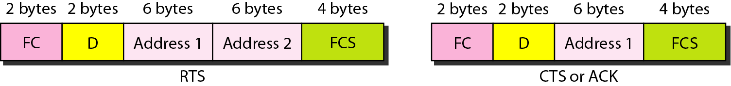

Frame Types
IEEE 802.11 has three categories of frames:
management frames:
used for the initial communication between stations and access points.
control frames.
used for accessing the channel and acknowledging frames
value of the type field is 01; the values of the subtype fields
data frames.
Data frames are used for carrying data and control information.

Slide 42
Addressing Mechanism
IEEE 802.11 addressing mechanism specifies four cases defined by the value of the two flags in the FC field, To DS and From DS
Each flag can be either 0 or 1, resulting in four different situations
The interpretation of the four addresses (address 1 to address 4) in the MAC frame depends on the value of these flags
Notes:
Each flag can be either 0 or I, resulting in four different situations.

Slide 43
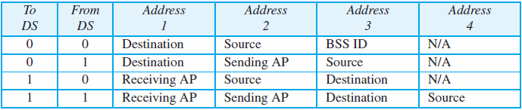
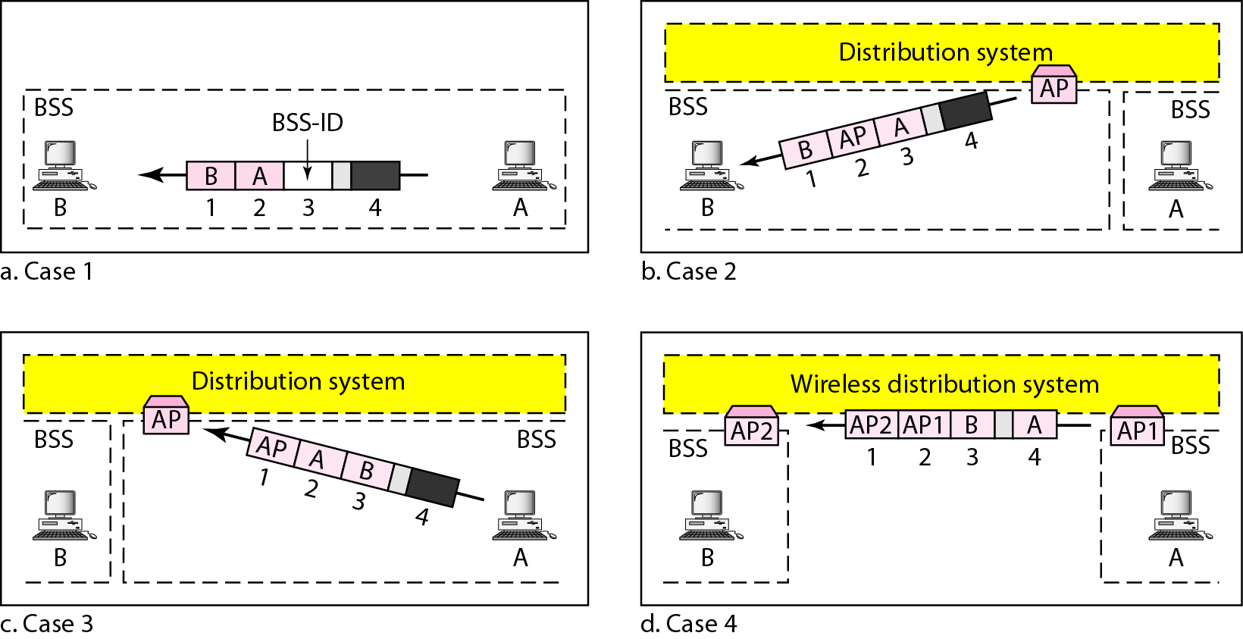
Addressing Mechanism

Slide 44
Addressing Mechanism
Case 1: 00, To DS = 0 and From DS = 0
This means that the frame is not going to a distribution system and is not coming from a distribution system.
The ACK frame should be sent to the original sender.
Case 2: 01, In this case, To DS = 0 and From DS = 1.
This means that the frame is coming from a distribution system (coming from an AP ).
The ACK should be sent to the AP
The addresses are as address 3 contains the original sender of the frame (in another BSS).

Slide 45
Addressing Mechanism
Case 3: 10, To DS =1 and From DS =O.
This means that the frame is going to a distribution system ( frame is going from a station to an AP)
The ACK is sent to the original station.
address 3 contains the final destination of the frame (in another BSS).
Case 4:11, To DS =1 and From DS =1.
This is the case in which the distribution the frame is going from one AP to another AP in a wireless distribution system.
We do not need to define addresses if the distribution system is a wired LAN because the frame in these cases has the format of a wired LAN frame (Ethernet, for example).
Here, we need four addresses to define the original sender, the final destination, and two intermediate APs.

Slide 46
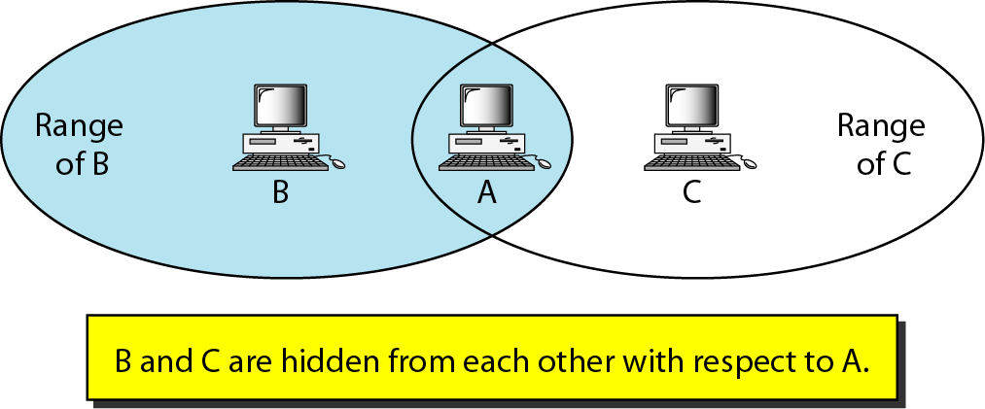
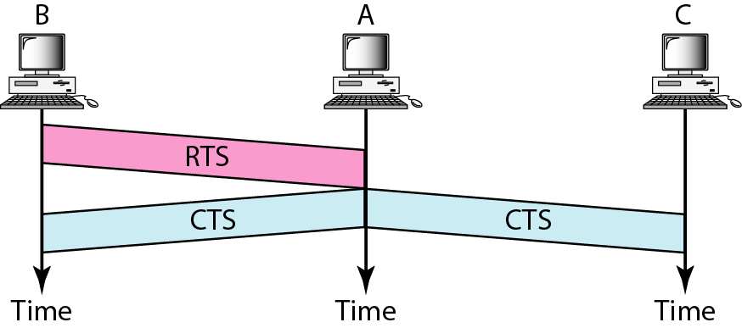
Hidden Station Problem
Notes:
The solution to the hidden station problem is the use of the handshake frames (RTS
and CTS) that we discussed earlier. Figure 14.11 shows that the RTS message from B
reaches A, but not C. However, because both Band C are within the range of A, the
CTS message, which contains the duration of data transmission from B to A reaches C.
Station C knows that some hidden station is using the channel and refrains from transmitting
until that duration is over

Slide 47
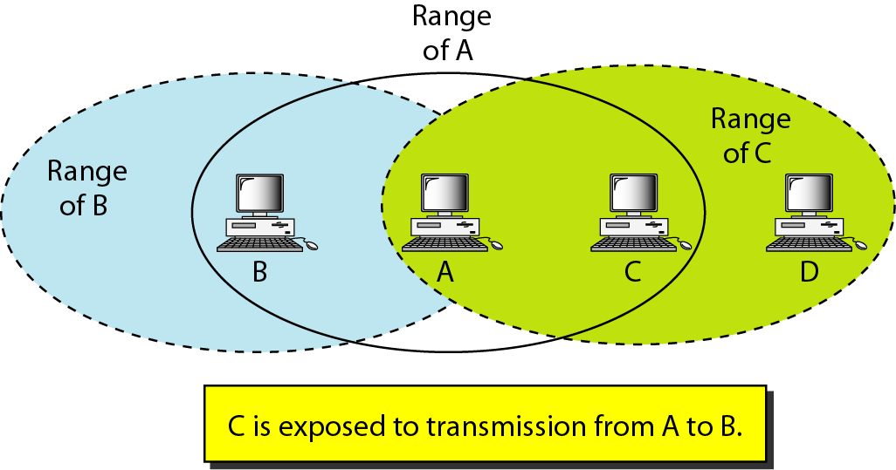
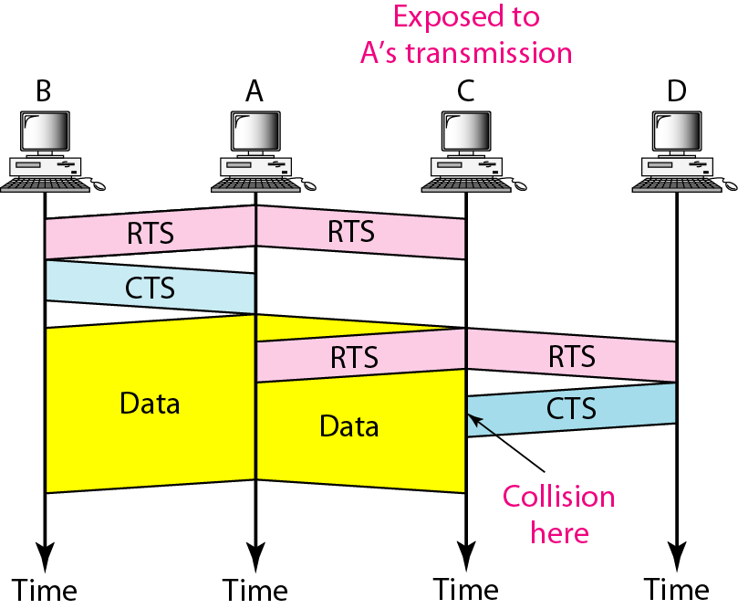
Exposed Station Problems
Station A is transmitting to station B.
Station C has some data to send to station D, which can be sent without interfering with the transmission from A to B
However, station C is exposed to transmission from A; it hears what A is sending and thus refrains from sending
The handshaking messages RTS and CTS cannot help in this case
Station C hears the RTS from A and refrains from sending, even though the communication between C and D cannot cause a collision in the zone between A and C; station C cannot know that station A’s transmission does not affect the zone between C and D.
Notes:
The handshaking messages RTS and CTS cannot help in this case, despite what you
might think. Station C hears the RTS from A, but does not hear the CTS from B. Station C,
after hearing the RTS from A, can wait for a time so that the CTS from B reaches A; it then
sends an RTS to D to show that it needs to communicate with D. Both stations B and A
may hear this RTS, but station A is in the sending state, not the receiving state. Station B,
however, responds with a CTS. The problem is here. If station A has started sending its
data, station C cannot hear the CTS from station D because of the collision; it cannot send
its data to D. It remains exposed until A finishes sending its data as Figure 14.13 shows.

